Slide 1


Slide 2
Web scraping with Beautiful Soup

Slide 3

Introduction to BeautifulSoup
What is BeautifulSoup
A Python library for parsing HTML and XML documents
How it works?
Works with the requests library to fetch web pages
Procedure
Extracts data from web pages in a hierarchical and readable manner

Slide 4
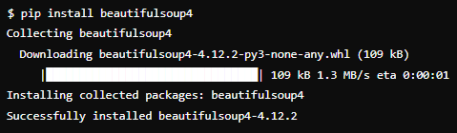
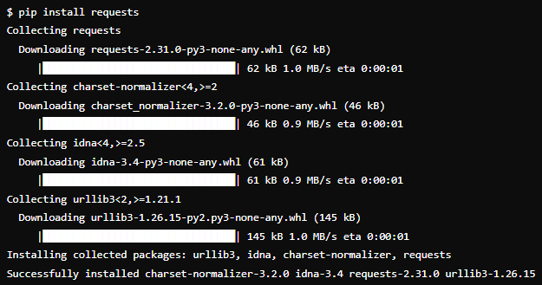
Setting Up the Environment
Install BeautifulSoup
Install requests

Slide 5

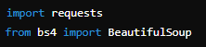
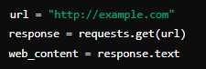
Basic Imports / Fetching
Importing Libraries
Fetching a Web Page with Requests

Slide 6
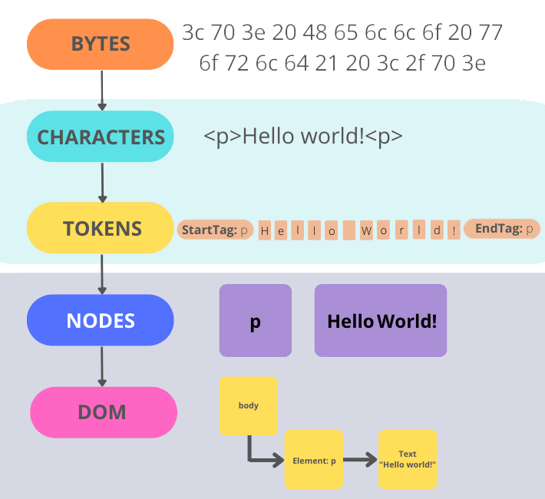
Parsing HTML
Parsing HTML with BeautifulSoup

Slide 7
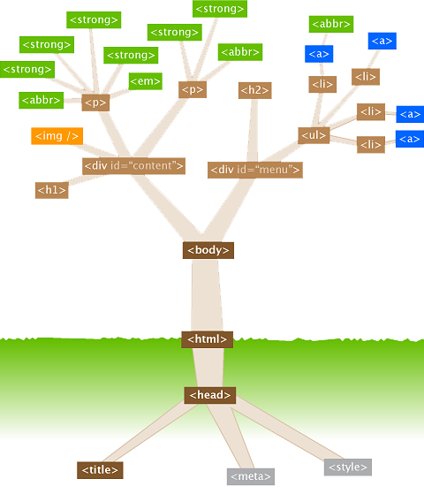
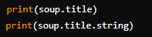
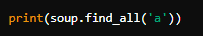
Navigating HTML Tree
Access elements by tags
Find elements

Slide 8
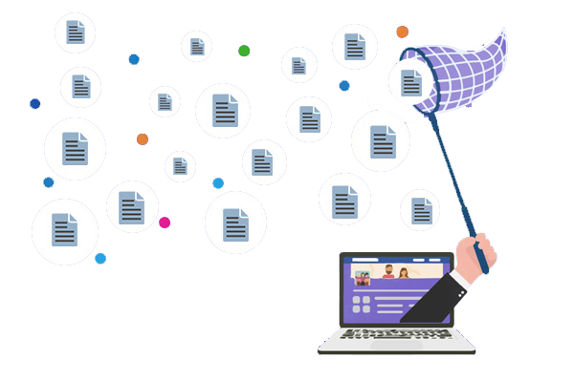
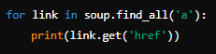
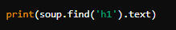
Extracting Information
Get text from elements
Extract specific data

Slide 9
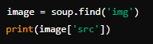
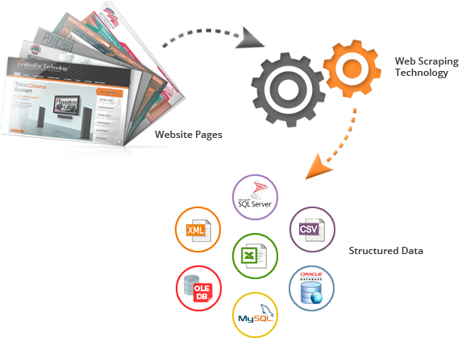
Working with Attributes
Access attributes of tags

Slide 10

BeautifulSoup Methods
find()
Find the first tag that matches
find_all()
Find all tags that match
get_text()
Extract all the text from the document
attrs
Access attributes

Slide 11
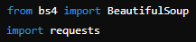
Extract Links from webpage
1
2
Basic imports
URL of the webpage
url = "https://immentia.com/"
3
4
Make a request to the webpage
Parse the HTML content
response = requests.get(url)
soup = BeautifulSoup(response.text, "html.parser")
5
6
Find all anchor tags
Extract the href attribute from each anchor tag
anchor_tags = soup.find_all("a")
links = [tag.get("href") for tag in anchor_tags]
7
Print all extracted links
for link in links:
print(link)

Slide 12
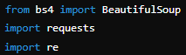
Extract Numbers from webpage
1
2
Basic imports
URL of the webpage
url = "https://immentia.com/"
3
4
Make a request to the webpage
Parse the HTML content
response = requests.get(url)
soup = BeautifulSoup(response.text, "html.parser")
5
6
Find all anchor tags
Extract the href attribute from each anchor tag
text = soup.get_text()
numbers = re.findall(r'\d+', text)
7
Print all extracted links
for number in numbers:
print(number)

Slide 13

In BeautifulSoup, what is used to parse HTML content?
BeautifulSoup() constructor
What function in BeautifulSoup allows you to find elements by their HTML tags?
find_all()
How do you install the BeautifulSoup library in Python?
pip install beautifulsoup4

Slide 14

Practice web scraping by extracting quotes from a webpage

